Slide 1
Newark vs. Jersey City
SAT business - client possibilities

Slide 2
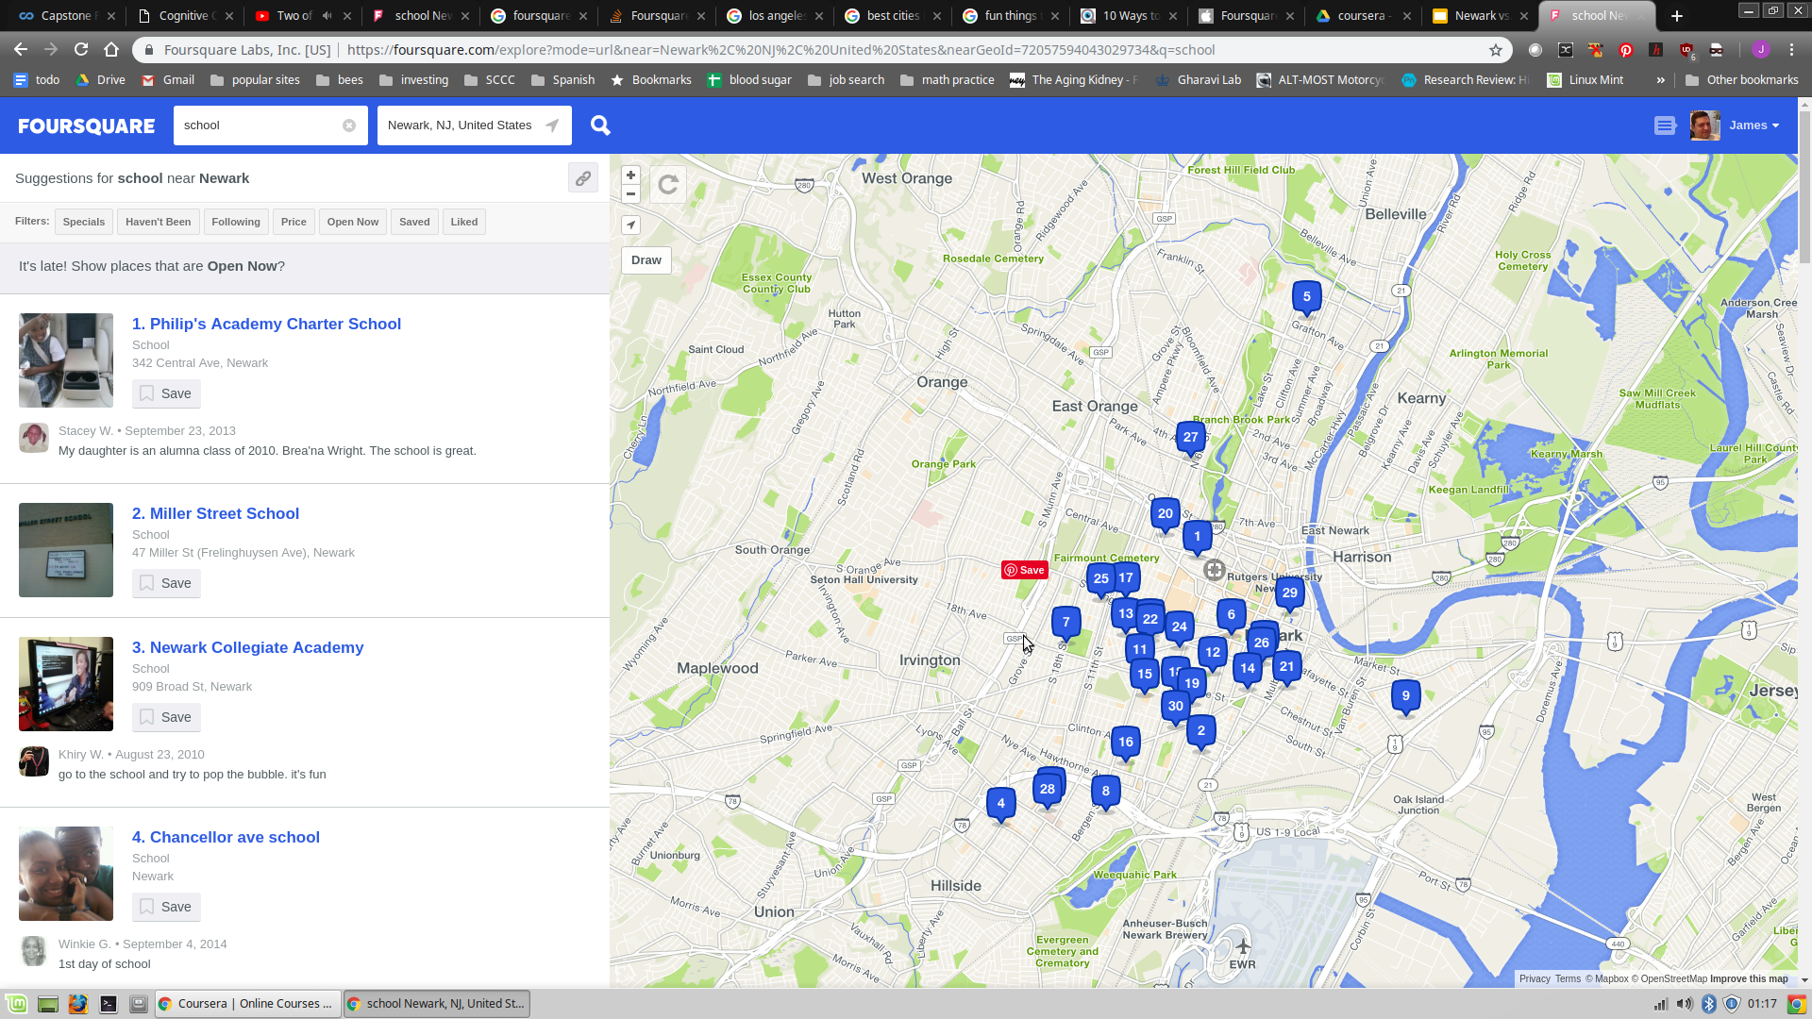
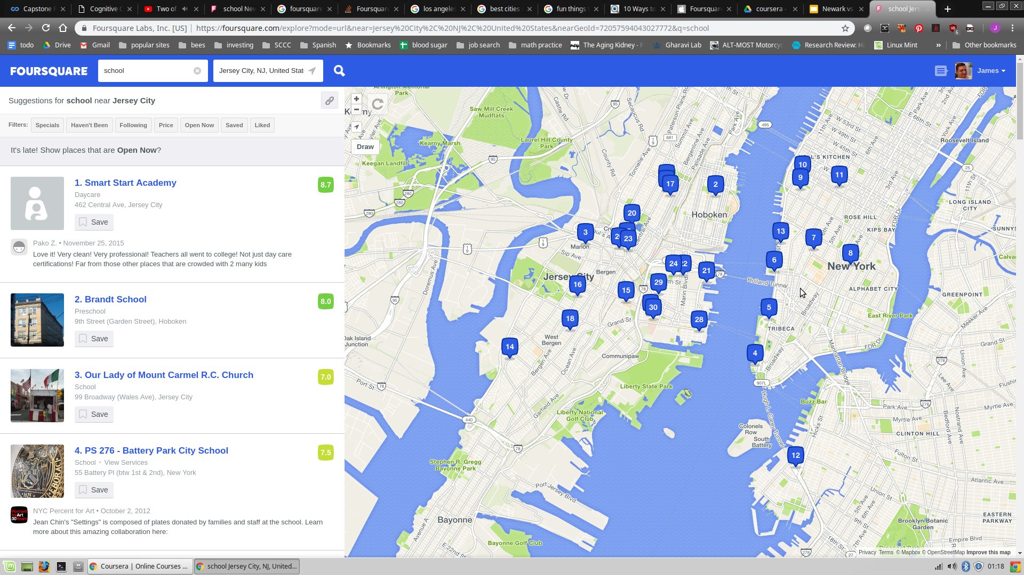
Description:
I am an SAT tutor, and am starting a business. I want to find out which city is best to start in. I want to see how many schools there are. I will count the number of schools, the more the better. I will also try to narrow it down to type of schools, for instance high schools, not colleges. I will also try to see if I can find out any other relevant information.

Slide 3
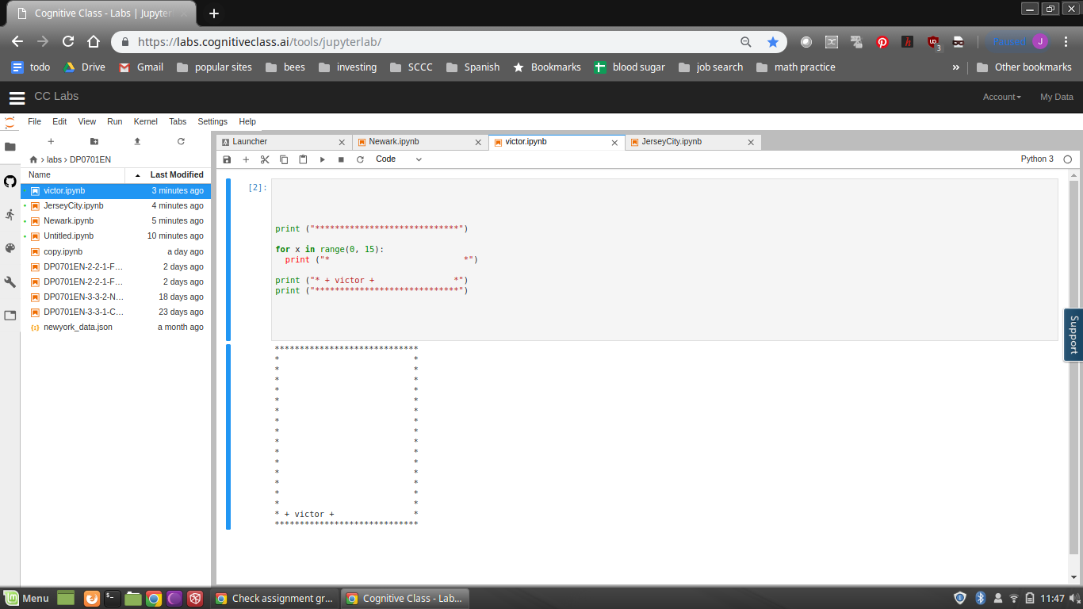

Slide 4
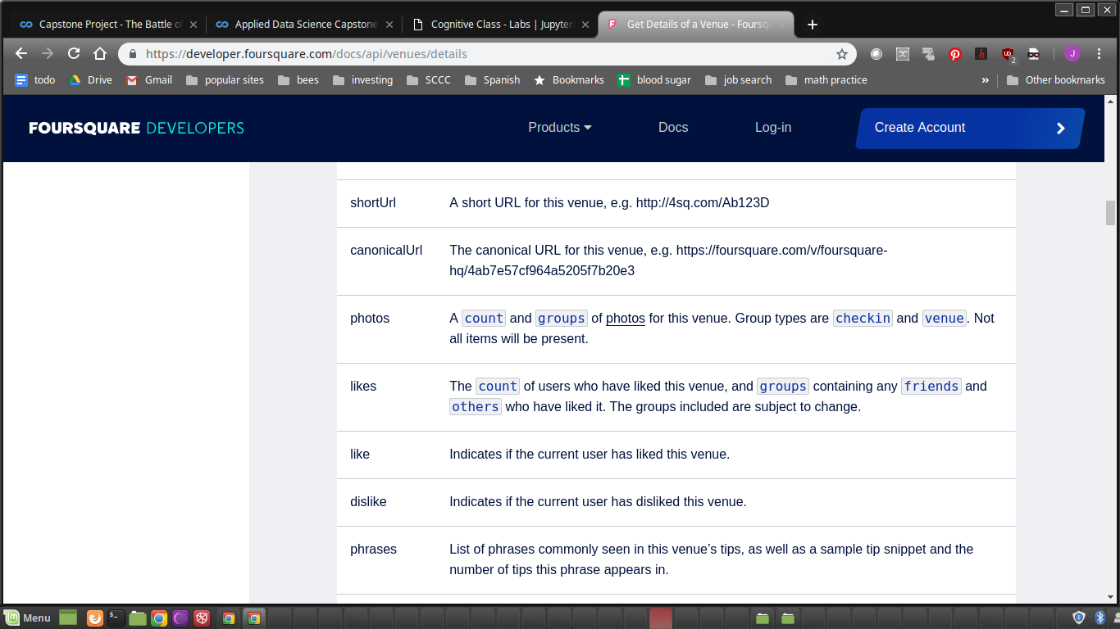
Will also compare likes

